Slide 1
Eat Up!!!

Slide 2
Welcome to The 1st Winter Quarter General BioClub Meeting

Slide 3
Meet Our Advisors
Dr. Lesley Boyd
Dr. Angela Horner

Slide 4
2015-2016 Club Shirts

Slide 5
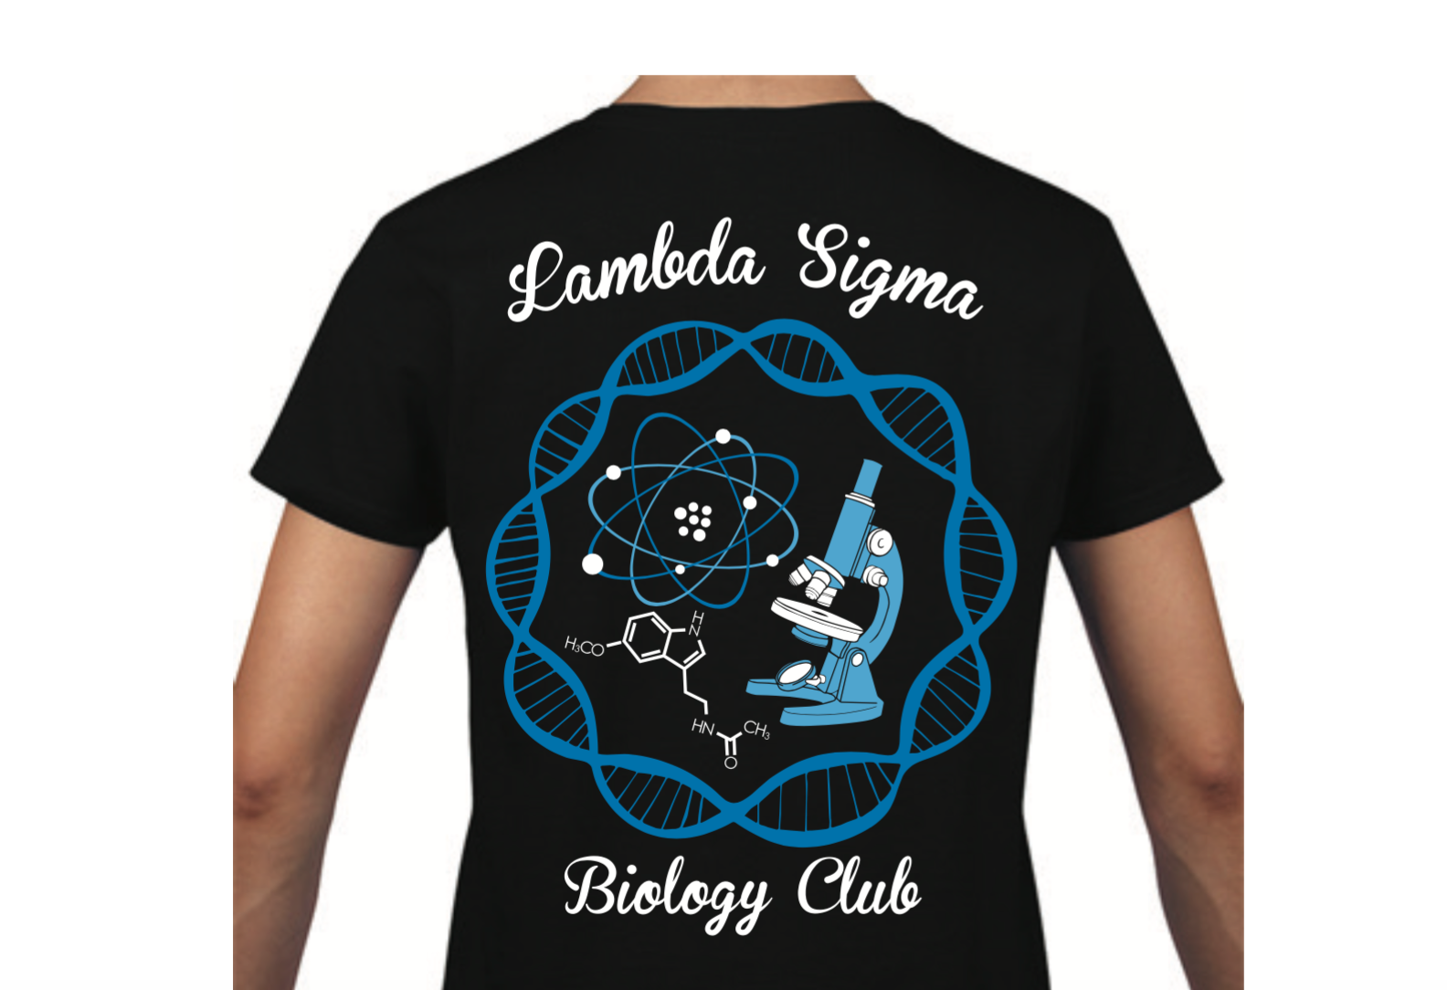
2015-2016 Club Shirts
Are currently getting made
Information on pick up will be sent out via email
Note: All shirts are in mens cut this year.
Note 2: Hoodies?

Slide 6
T-Shirt Friday
Show your love for BioClub by wearing your t-shirts next Friday, February 12th, 2015

Slide 7
ProgramminG Coordinator :
Val
Mejia

Slide 8
Programming Events
What: Medical School Wks. w/ co-host AMSA
Speaker: Dr. Boyd
When: TBA
Where: TBA

Slide 9
Programming Events
What: Presenting in the Sciences w/co-host SSSCR
Speaker: Lowell Iporac
When: TBA
Where: TBA

Slide 10
Social Coordinator and Field Trip Coordinator:
Crystal Litak and Edith Andrade

Slide 11
Group Trip
Six Flags
Laser Tag
Suggestions?

Slide 12
How to Join
Membership Application
2nd and 3rd Floor Message Boards
Official Club Website http://bioclubcsusb.weebly.com/how-to-join.html
Membership Fee
$15 for New Members
$10 for Returning

Slide 13
How to Join
Methods of Contact
Club email → biologyclubatcsusb@gmail.com
Social media →
facebook.com/bioclubcsusb
twitter.com/BioClubCSUSB
Instagram @lambdasigmabioclub

Slide 14
Thank you for coming and we’ll see you next time!

